Slide 1
BUSINESS PRESENTATION TEMPLATE
Quisque velit nisi, pretium ut lacinia in, elementum id enim. Cras ultricies ligula sed magna dictum porta. Quisque velit nisi, pretium ut lacinia in, elementum id enim. Vivamus magna justo, lacinia eget consectetur sed.
LPG gas leakage detector alarm using arduino nano
Project batch-09
Coordinator:- A.padmavathi
Leader:-E.Ajaykumar-062
D. Shravya-089
ABC. Akhil-080
G.kamalraj-096
S.Chandrakanth-119

Slide 2
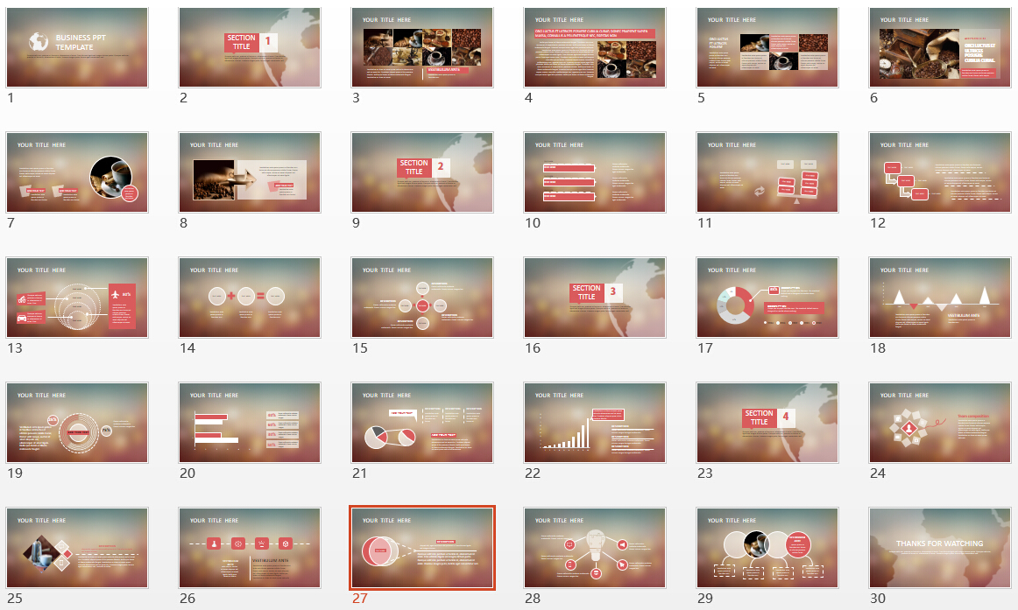
INTRODUCTION
Liquefied petroleum gas (LPG) is currently the most used gas in our home for cooking purposes. LPG gas is a flammable gas, if leaked it can cause major damage to life and property. Therefore it should be used in safe handling manner and additional care has to be taken in order to prevent any leakage possible. Nowadays people are having very busy schedule that they forget to turnoff the burner which may also lead to damages. Our proposed topic aims at detection of gas leakage. The smart gas system which provides home safety.

Slide 3
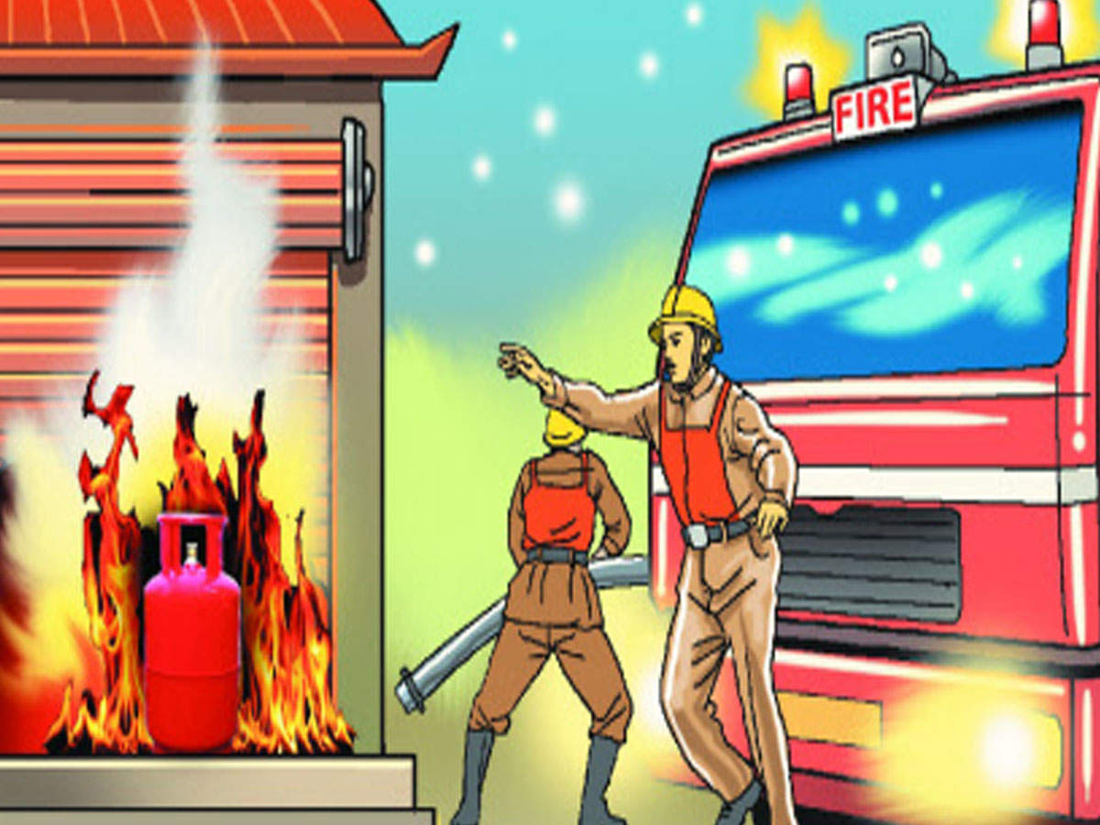

AIM:-
The Main aim of our project is to prevent explosions and provide safety. In our system sensor is used to detect the leakage. Our aim is to reduce risks in kitchen With a small circuit.
VESTIBULUM ANTE
ipsum primis in faucibus orci luctus et ultrices posuere cubilia Curae
Vestibulum ante ipsum primis in faucibus orci
Vestibulum ante ipsum primis in faucibus orci
Vestibulum ante ipsum primis in faucibus orci
Vestibulum ante ipsum primis in faucibus orci

Slide 4

SECTION TITLE
1
Quisque velit nisi, pretium ut lacinia in, elementum id enim. Cras ultricies ligula sed magna dictum porta. Quisque velit nisi, pretium ut lacinia in, elementum id enim. Vivamus magna justo, lacinia eget consectetur sed.
Block diagram
Buzzer
Mq-135
Sensor
Arduino
Nano
LED
Power source

Slide 5
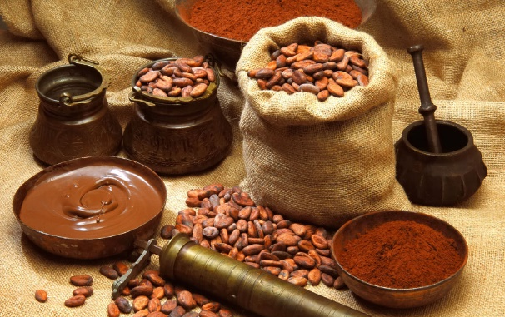
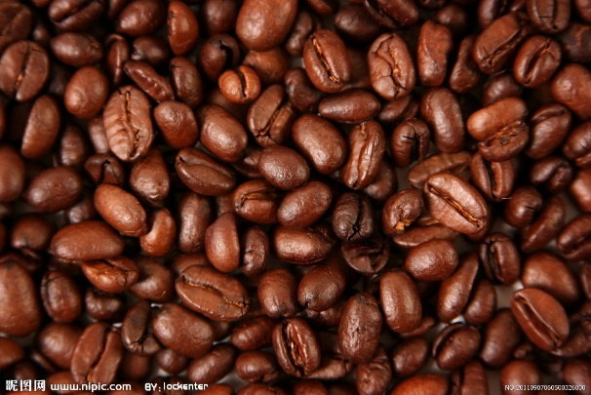
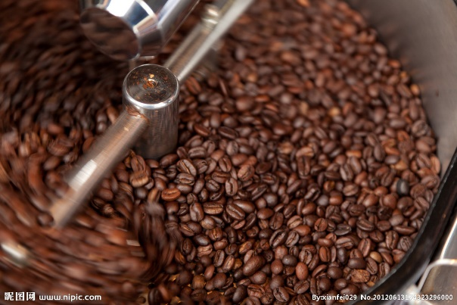





Your Title Here
Explanation
* The proposed system consist of Arduino Nano. It is interfaced to sensor i.e, Mq-135 sensor, buzzer and LED.
* The method takes an automatic control action upon detection of gas.
* Initially if there is a gas leakage and when sensor detects it ,then the output of it goes high.
* This signal is sensed by arduinoNano.
* Then arduino nano will produce an output signal which is fed to buzzer and LED which makes them ON.
Vestibulum ante ipsum primis in faucibus orci
Vestibulum ac diam sit amet quam vehicula elementum sed sit amet dui. Curabitur aliquet quam id dui posuere blandit. Nulla quis lorem ut libero malesuada feugiat. Vestibulum ac diam sit amet
VESTIBULUM ANTE

Slide 6
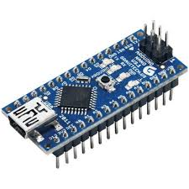
Your Title Here
Nulla quis lorem ut libero malesuada feugiat. Curabitur arcu erat, accumsan id imperdiet et, porttitor at sem. Nulla quis lorem ut libero malesuada feugiat. Vivamus suscipit tortor eget felis porttitor volutpat. Vestibulum ante ipsum primis in faucibus orci luctus et ultrices posuere cubilia Curae; Donec velit neque, auctor sit amet aliquam vel, ullamcorper sit amet ligula. Cras ultricies ligula sed magna dictum porta. Proin eget tortor risus. Curabitur non nulla sit amet nisl tempus convallis quis ac lectus. Praesent sapien massa, convallis a pellentesque nec, egestas non nisi. Vivamus suscipit tortor eget felis porttitor. Nulla quis lorem ut libero malesuada feugiat. Curabitur arcu erat, accumsan id imperdiet et, porttitor at sem. Nulla quis lorem ut libero malesuada feugiat. Vivamus suscipit tortor eget felis Praesent sapien massa, convallis a pellentesque nec, egestas non nisi. Vivamus suscipit tortor eget felis porttitor. Nulla quis lorem ut libero malesuada feugiat.
ORCI LUCTUS ET ULTRICES POSUERE CUBILIA CURAE; DONEC PRAESENT SAPIEN MASSA, CONVALLIS A PELLENTESQUE NEC, EGESTAS NON
Components
1.ARDUINO NANO
The Arduino Nano is a small, complete, and breadboard-friendly board based on the ATmega328P. It offers the same connectivity and specs of the Arduino Uno board in a smaller form factor. The Arduino Nano is programmed using the Arduino Software integrated development environment (IDE), which is common to all Arduino boards and running both online and offline.
Features of Arduino Nano are:- It has 22 input/output pins in total. • 14 of these pins are digital pins. • Arduino Nano has 8 analogue pins. • It has 6 PWM pins among the digital pins. • It has a crystal oscillator of 16MHz. • It's operating voltage varies from 5V to 12V. • It also supports different ways of communication, which are: • Serial Protocol. • I2C Protocol. • SPI Protocol. • It also has a mini USB Pin which is used to upload code. • It also has a Reset button on

Slide 7
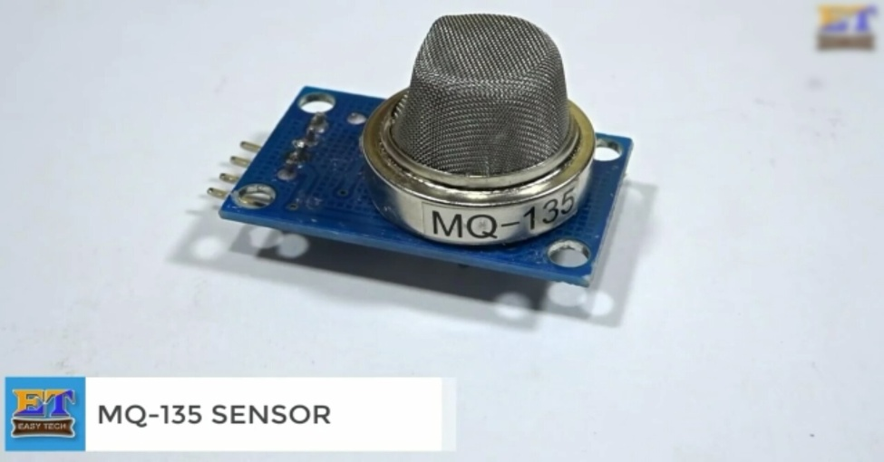
2. MQ-135 SENSOR
Q-135 is an air quality or air pollution measuring sensor device. It can detect various chemical contents in air and give appropriate voltage variation at the output pin depending on the chemical concentration in air.
It can detect alcohol, Benzene, smoke, NH3, butane, propane etc. if anyone of the stated chemical concentration rises, the sensor convert the chemical concentration in air to appropriate voltage range, which can be processed by Arduino or any microcontroller. It cannot tell what kind of chemical concentration rose in the air.
It has 4 pins { VCC , GND , AO & DO }.
Features:
High Sensitivity.
High sensitivity to Ammonia, Sulfide and Benze.
Stable and Long Life.
Detection Range: 10 - 300 ppm NH3, 10 - 1000 ppm Benzene,
10 - 300 Alcohol.
Heater Voltage: 5.0V.
Dimensions: 18mm Diameter, 17mm High excluding pins, Pins - 6mm High.
Long life and low cost.

Slide 8
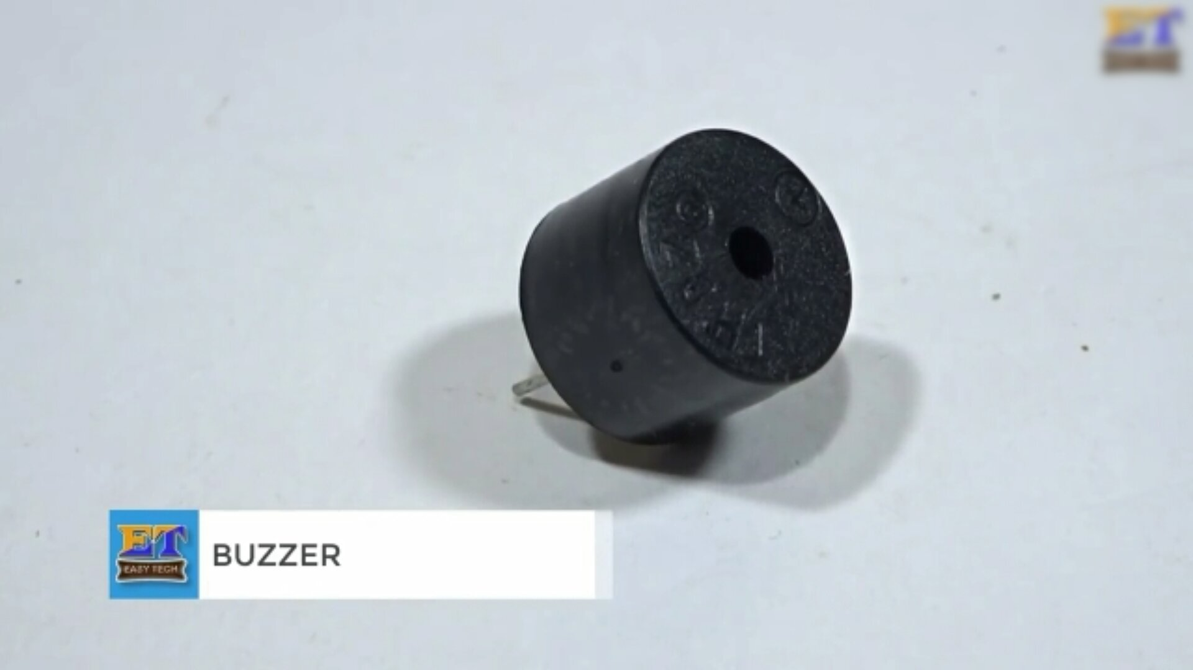
3.BUZZER
A buzzer or beeper is a audio signalling device which may be mechanical, electromechanical or piezoelectric(piezo for short). Typical usage of buzzer and beeper include alarm devices, Timmers and conformation of user input such as much click or keystroke
Features of the buzzer:-
• Operating Voltage: 4-8V DC
• Rated current: <30mA
• Sound Type: Continuous Beep
• Resonant Frequency: ~2300 Hz
• Small and neat sealed package

Slide 9
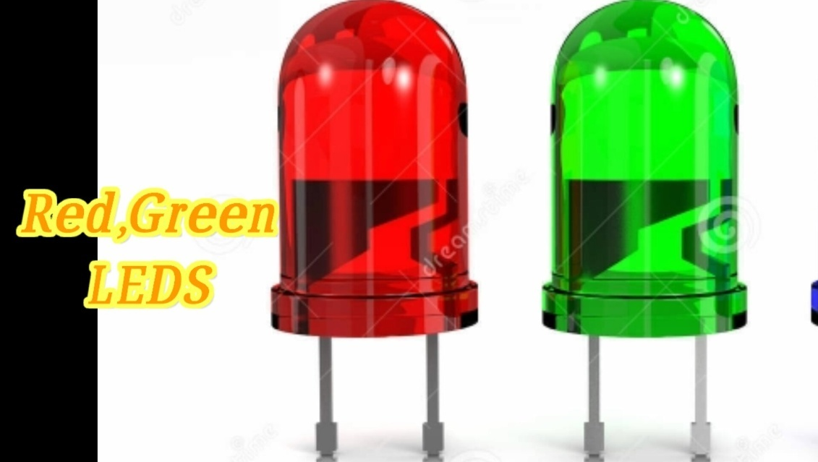
4.LEDS { RED ,GREEN }
light-emitting diode (LED) is a semiconductor device that emits light when an electric current is passed through it. Light is produced when the particles that carry the current (known as electrons and holes) combine together within the semiconductor material.
Red LED is made using aluminum indium gallium phosphide (AlInGaP).
Green LED is made using Indium
gallium nitride (InGaN).
Features :-
* More energy efficient.
* Operates at a much lower temperature
(cool to the touch)
* Environmentally Friendly.

Slide 10
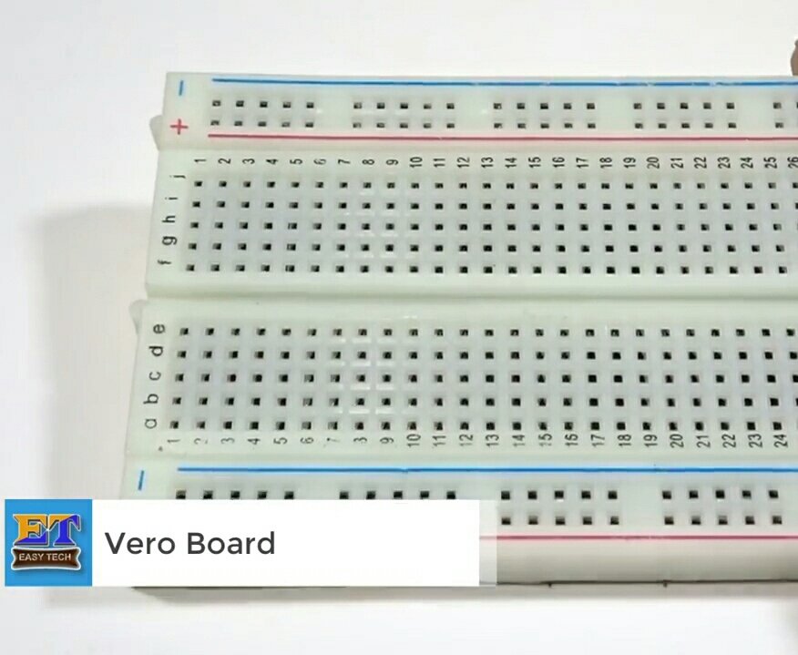
5.Breadboard
Breadboard is to make quick electrical connections between components- like resistors, LEDs, capacitors, etc- so that you can test your circuit before permanently soldering it together.
Breadboards have many small sockets on them, and some groups of sockets are electrically connected to each other.

Slide 11
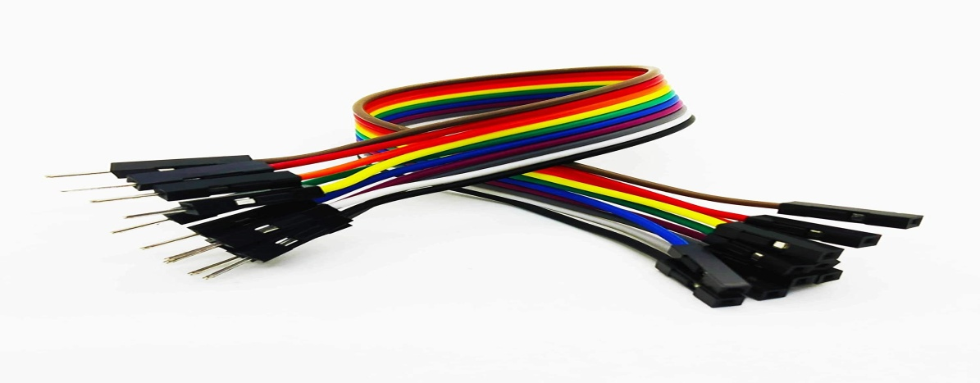
Your Title Here
ORCI LUCTUS ET ULTRICES POSUERE CUBILIA CURAE.
6.CONNECTORS
Jumper wires are used for making connections between items on your breadboard.
Jumper wires are simply wires that have connector pins at each end, allowing them to be used to connect two points to each other without soldering. Jumper wires are typically used with breadboards and other prototyping tools in order to make it easy to change a circuit as needed.
ADD YOUR TEXT
Vestibulum ante ipsum primis in faucibus orci luctus et ultrices posuere cubilia Curae; Donec velit neque.
Notes:
6.CONNECTORS

Slide 12
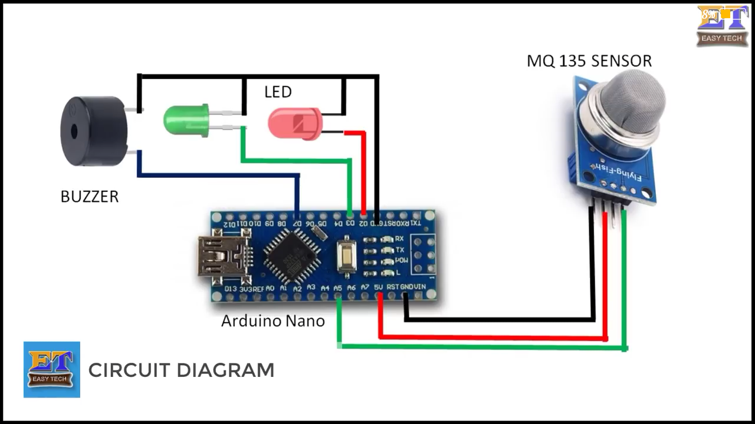
THANK
CIRCUIT DIAGRAM
_
+
+
+
GND
V0
VCC
LPG gas leakage detector alarm
Using arduino nano
YOU
sed.

Slide 13
Your Title Here
Vestibulum ante ipsum primis in faucibus orci luctus et ultrices posuere cubilia Curae; Donec velit neque, auctor sit amet aliquam vel, ullamcorper sit amet
ORCI LUCTUS ET ULTRICES POSUERE
Vestibulum ante ipsum primis in faucibus orci luctus et ultrices posuere cubilia Curae; Donec velit neque, auctor sit amet aliquam vel, ullamcorper sit amet
Vestibulum ante ipsum primis in faucibus orci luctus et ultrices posuere cubilia Curae; Donec velit neque, auctor sit amet aliquam vel, ullamcorper sit amet
Advantages
* Detection and prevention of any sort of gas leakage.
* cost efficient
*less complex circuit.
* No environmental effect.
* It is used in household's as LPG gas leakage, which reduce the huge loss of property and life.
Vestibulum ante ipsum primis in faucibus orci luctus et ultrices posuere cubilia Curae; Donec velit neque, auctor sit amet aliquam vel, ullamcorper sit amet

Slide 14
THANK
YOU
sed.

